Slide 1
Agenda item( 5)
Agenda item( 5)
Agenda item( 5)
Production:
coverage
periodicity
response rate
questionnaires
Nicolas Sakoff:
Nicolas.Sakoff@fao.org

Slide 2

Estimation of the Food availability
Supply
Utilization
=
Opening
Stock
Exports
Domestic
utilization
Imports
Closing
Stock
Production
Feed
Seed
FOOD
Waste
Processing
for food
Other
utilization

Slide 3
General Overview
Commodities 633
Crops & processed 421
Livestock & processed 212
Primary Crops 173
Primary Livestock 61
Coverage: 1961-2009

Slide 4

MAIN CROP GROUPS
CEREALS
ROOTS AND TUBERS
SUGAR CROPS
PULSES
NUTS
OIL CROPS
VEGETABLES
FRUIT
STIMULANTS
SPICES
FORAGE PRODUCTS
TOBACCO
NATURAL RUBBER
FIBERS, VEGETAL OR ANIMAL ORIGIN

Slide 5
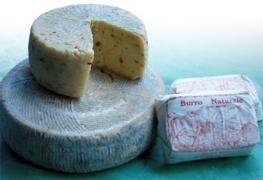

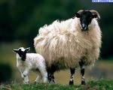
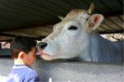
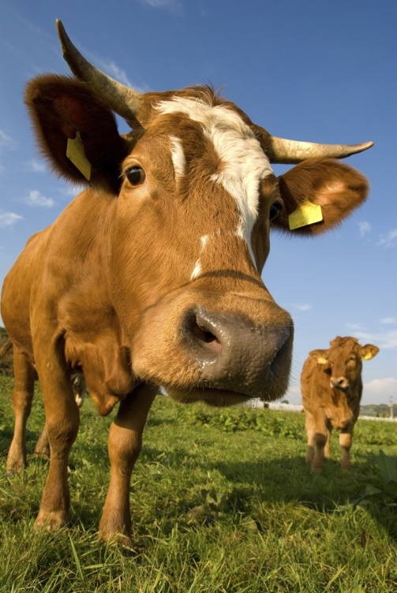
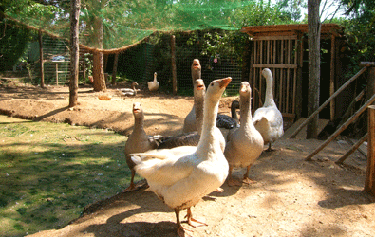
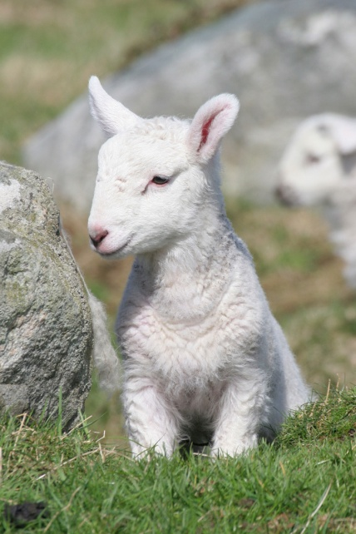
LIVESTOCK AND PRODUCTS
Livestock – Live Animals
Product from Slaughtered Animals
Products from Live Animals

Slide 6
SELECTED DERIVED AGRICULTURAL COMMODITIES
SUGAR, RAW, CENTRIFUGAL
VEGETABLE OILS
CAKES
FRUIT PREPARATION
ALCOHOLIC BEVERAGES

Slide 7
Data Sources
Yearly Production Questionnaires
National Publications
National web sites
International Sources (Licht, Oilworld, OIV)
FAO Divisions &UN Statistics Divisions
Other Regional Organizations (Eurostat,Afristat,AEOD)
Other sources (Reuter, USDA,meetings)

Slide 8
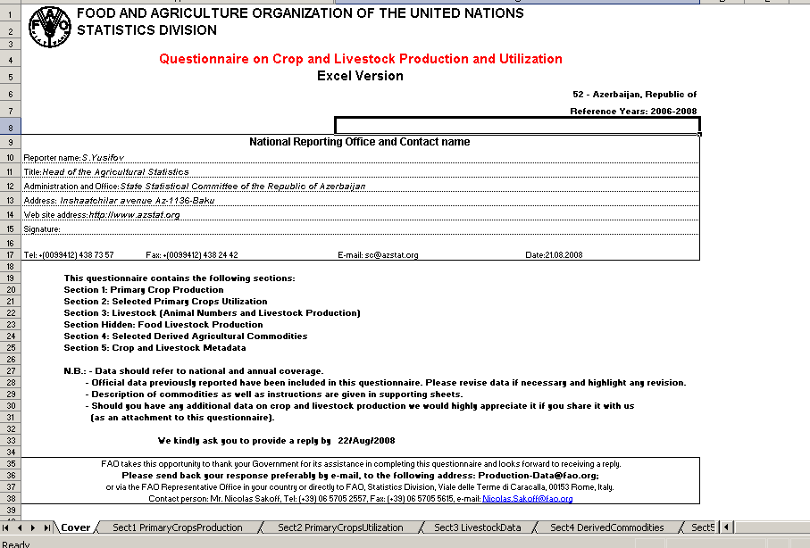

Slide 9
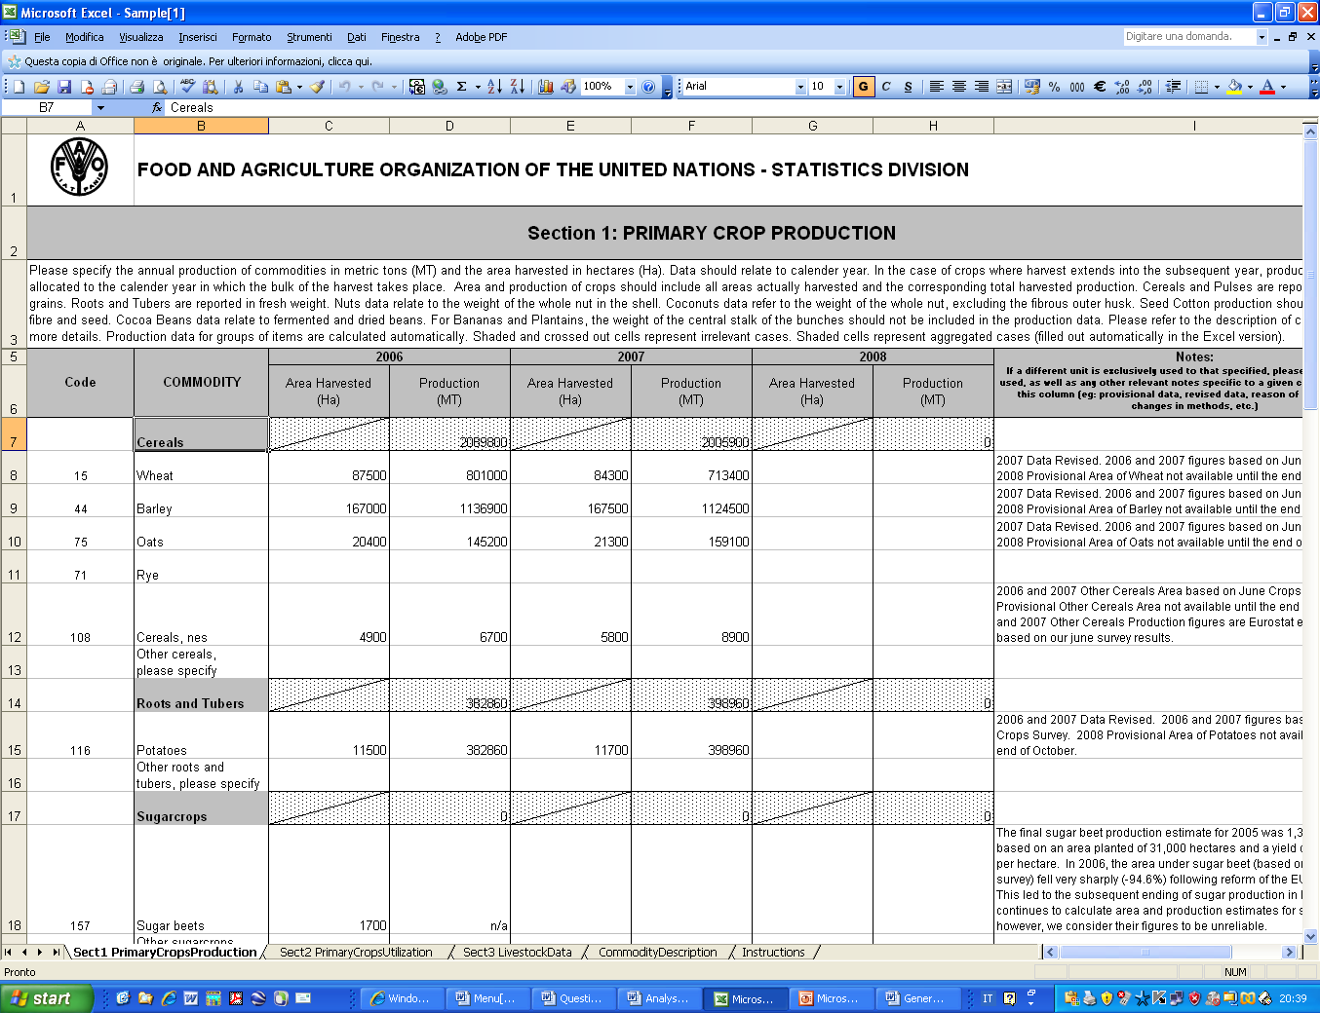

Slide 10
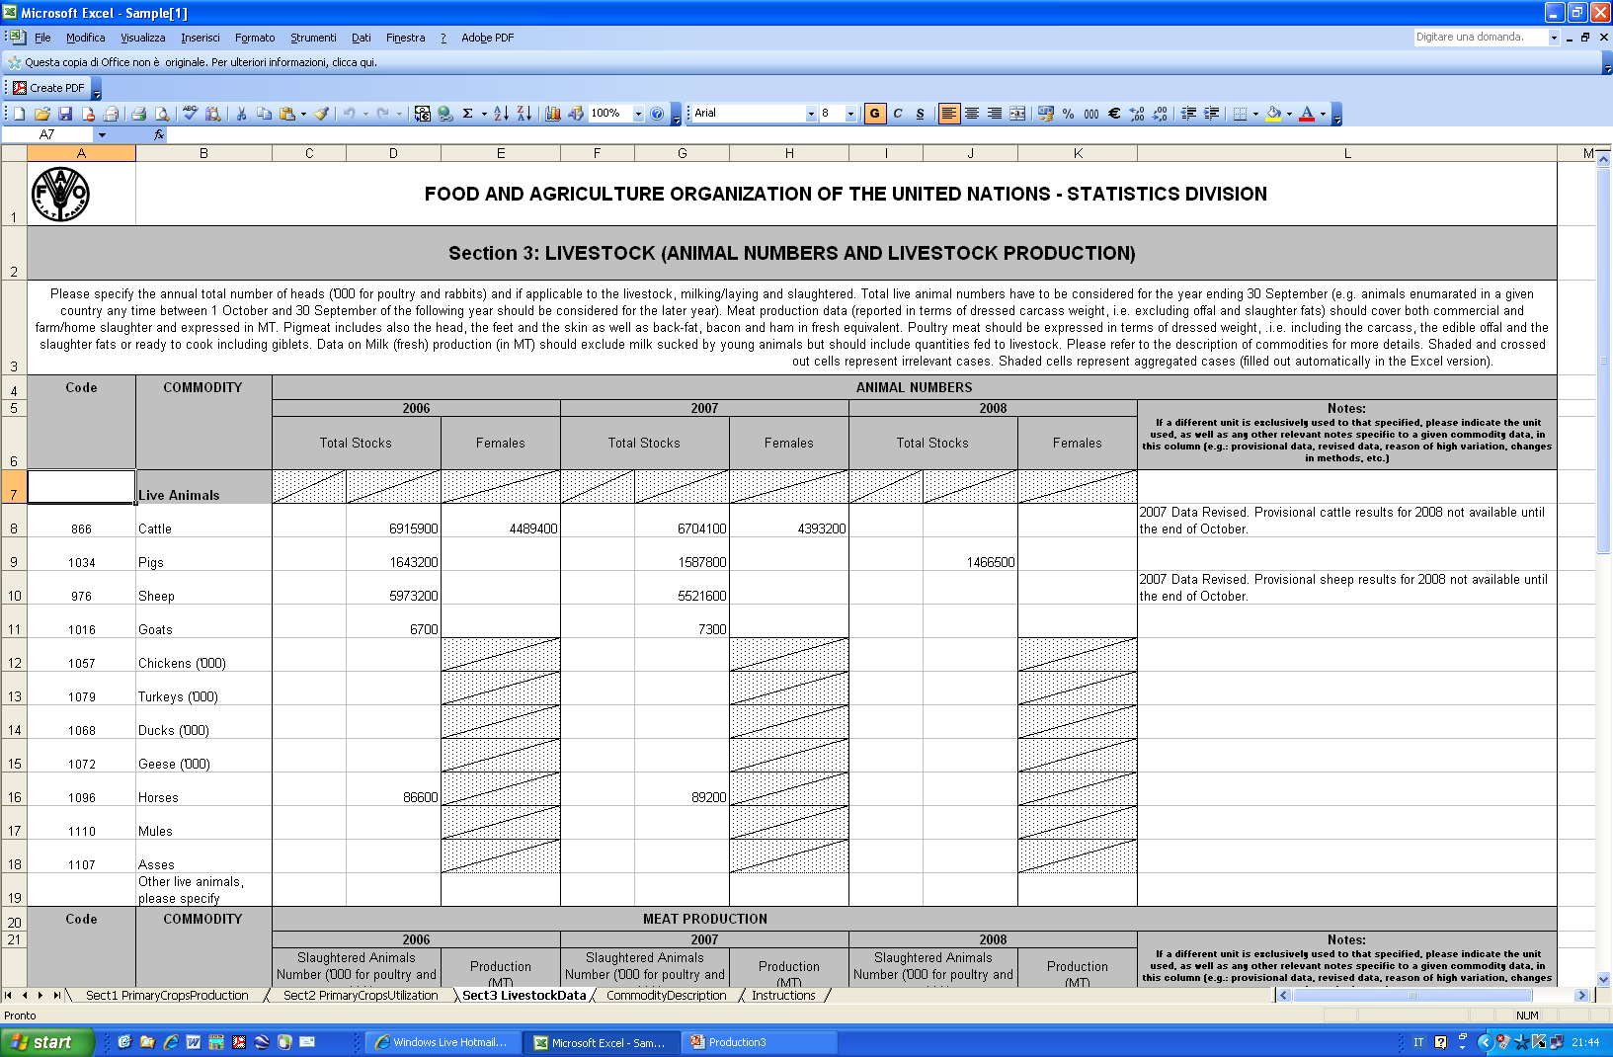

Slide 11
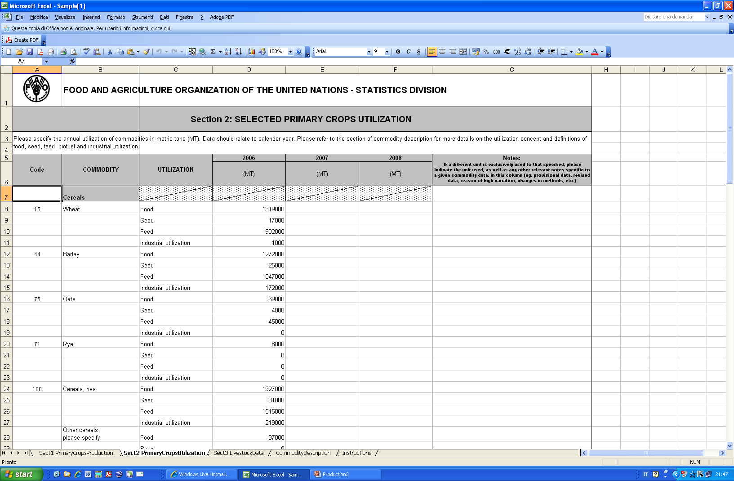

Slide 12
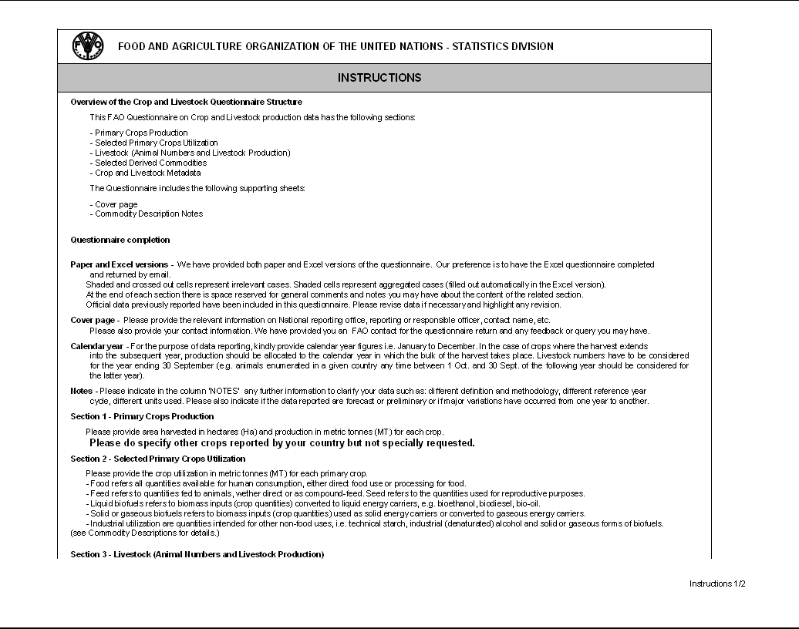

Slide 13
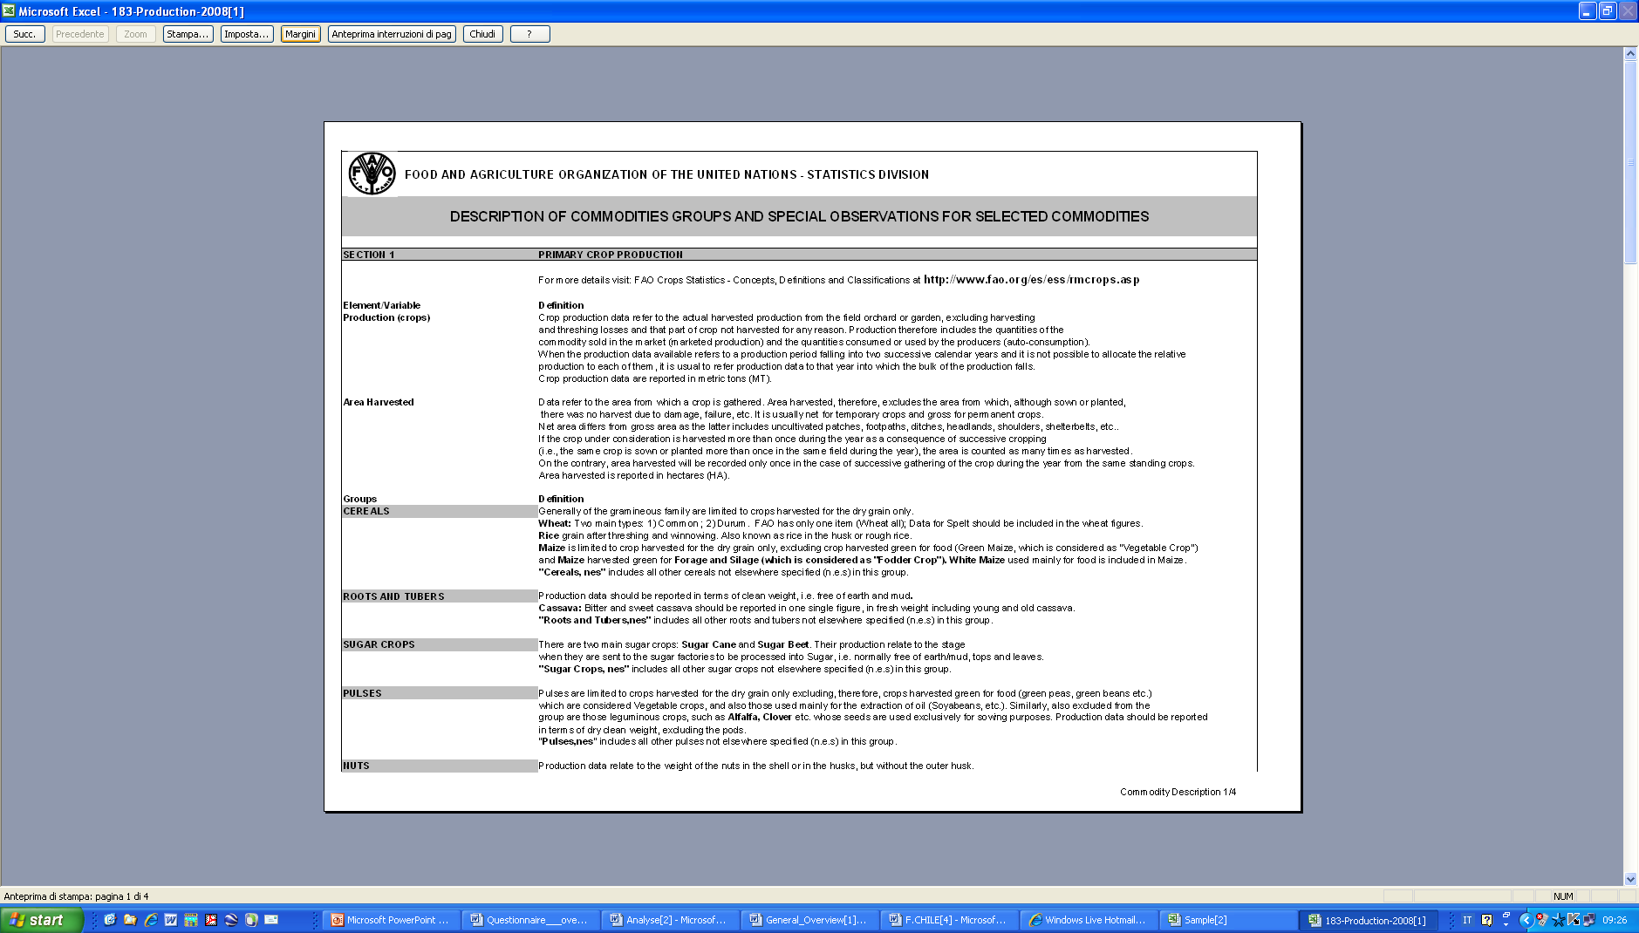

Slide 14
World wide response rate to the FAO production questionnaires

Slide 15
Table 1
 | 2005 |  | 2006 |  | 2007 |  | 2008 |  | 2009 |  | 2010 |  | 2011
 | Reporting countries | Response rate | Reporting countries | Response rate | Reporting countries | Response rate | Reporting countries | Response rate | Reporting countries | Response rate | Reporting countries | Response rate | Reporting countries | Response rate
Africa | 8 | 15 | 16 | 30 | 20 | 38 | 18 | 34 | 14 | 27 | 30 | 58 | 26 | 50
America | 15 | 36 | 17 | 41 | 12 | 28 | 15 | 35 | 15 | 36 | 16 | 38 | 17 | 40
Asia& Oceania | 15 | 25 | 27 | 45 | 23 | 38 | 25 | 43 | 33 | 55 | 40 | 66 | 38 | 63
Europe | 35 | 69 | 31 | 61 | 32 | 64 | 30 | 58 | 33 | 65 | 30 | 59 | 34 | 66
World | 73 | 40 | 91 | 50 | 87 | 48 | 88 | 49 | 95 | 52 | 116 | 64 | 115 | 64

Slide 16
 |  | FAOSTAT
 |  | 2010 Production data
Country code | Country | Total Production Cells | Production Cells with Official reported data | Share of Official Data
 | Bhutan
5400 | Europe | 7435 | 4349 | 58
5100 | Africa | 6246 | 1733 | 28
5200 | America | 5854 | 2249 | 38
5300 | Asia | 7965 | 3693 | 46
5500 | Oceania | 1429 | 142 | 10
5000 | World | 28929 | 12502 | 43

Slide 17
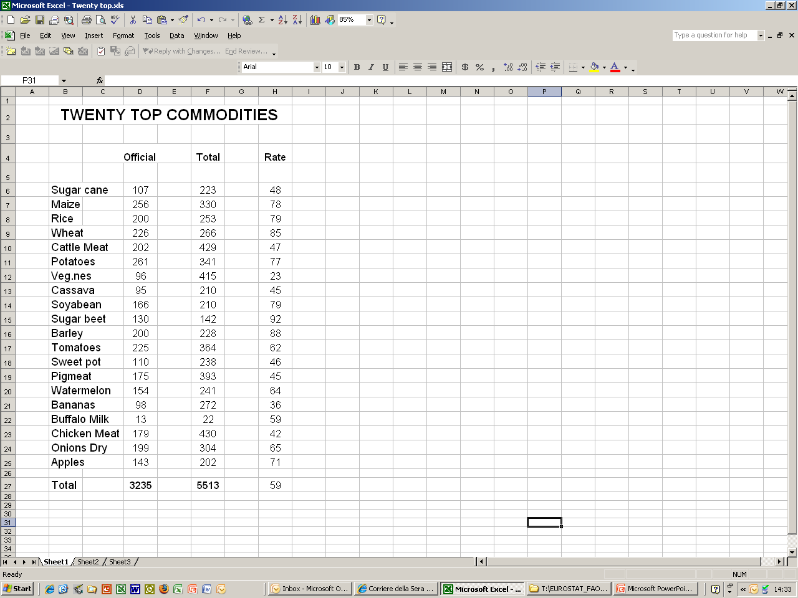

Slide 18
Thank you for your attention

